Slide 1
Meeting Notes
Compiled

Slide 2
Week | ACTIVITY 1 | ACTIVITY 2 | ACTIVITY 3 | ACTIVITY 4
2/27 | Prototype of body/chassis | Define motor req | Define container | Define sensor technology
3/6 | Define ball collector mechanism
3/13 (SPRING BREAK)
3/20 | Validate sensor technology
3/27
4/3 | 1st Design Critique
4/10
4/17 | 2nd Design Critique
4/24 |  |  | Report and Due day

Slide 3
Meeting Notes
Friday, Feb 17

Slide 4
Discussion
Need to have rough idea of prototype by spring break to begin ordering parts
Meet 2x a week until spring break
Tuesday 7 PM - weekly
Thursday 7 PM - weekly
Possibly additional meeting (March 3rd I think it was??)
Image processing is slow
Not accurate
Not robust to different lighting
Infrared could be a good option
Ultra sonic would be difficult with walls reflecting
possibly split team into subsystems : mechanical and electrical
Corral the balls versus pick them up
Compartment door could be passive by having it swivel on a hinge

Slide 5
Product Attributes
Robot
Drive motor/gears
Chassis
Wheels
Axles
Collecting system
Drive
Mechanism
Sensors
Detect wall
Detect ball
Detect compartment
Decorations
Body
Control board
Battery
Compartment (12”x10”x6”)
Door (8”x6”)
Lift mechanism
Lift drive
Control board
Battery
Walls
Sensors
Decoration
Lighting
Transportation Carrier (12”x12”x12”)

Slide 6
Alumni Discussion
Feb 22, 2017

Slide 7
Alumni meet discussions
Points noted:
Options for sensing the balls:
IR sensors (noise and rangle problems)
Ultrasonic (noise problems)
Image sensors (pixy- compatible with raspberry pi, slow and takes more processing time but easier bot manipulation)
To detect and align with container:
Hall effect sensor (short range distance)
Beacon (light emitting/wireless) (wireless-complicated)
Use limit switches to detect collision with walls and helping in repositioning bot
Can use encoders for position calculations but very tough to retrace steps
Choose good friction tyres to avoid slip
Brake/reverse motors if we want to push the balls out
Design top loading container as it can be placed in any orientation

Slide 8
Meeting Notes
Feb 23, 2017

Slide 9
Discussion
Container can be placed in any orientation in any corner therefore it might be necessary to drop balls in from the top or have doors on every side
Discussed how a claw armature would be easiest for dropping ball into the top of container
Discussed a possible container that raises from the middle so can be accessed from all sides, rubber band “arena” would keep balls from escaping from container
Pixy discussed as a possible way of finding balls.. $70+$40
3 wheels for vehicle (2 drive, 1 caster)
Motors : DC or Step
Have code for each
Need to have a weekly 1.5 hour meeting set - Monday’s are preference since ordering days are Tuesday and Thursday
Timeline
Before spring break
Define container
Rough prototype of vehicle
Motors
Ball carrying method
To Do: Research motors *must order by 2/29
Possible option Nema 17 bipolar step motor 3.5V

Slide 10
Meeting Notes
Feb 27, 2017

Slide 11
Discussion
Motor
Still trying to determine if DC or Step motor is the best solution - decided to test both - senior design lab has several different motors we could use if we have a driver
Decided not to spend our time designing for balls in the corner, if there is time near the end of the project we can implement a method for getting balls that are in the corner
RPM
Determined that 2.5m/3s (0.83m/s) is fast
With a 10 cm diameter wheel, vehicle RPM 158, motor RPM 5283.9
Motor rated 5000 step/s = 1500 RPM
Wheels should be 10 cm
Meet Thursday at 8 PM
Test motors
Andria to bring body prototype materials

Slide 12
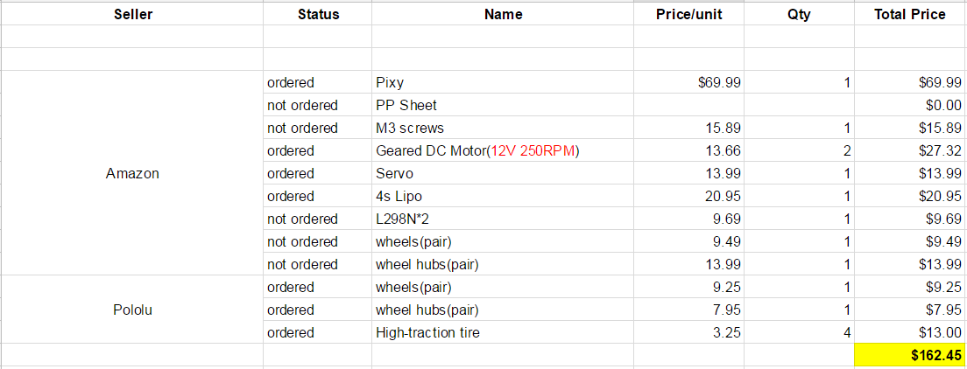
1st Order Request (2/28)

Slide 13
Meeting Notes
March 2, 2017

Slide 14
Discussion
Andria’s friend asked prof/TA about balls being near the wall, they said they will not be placed near the wall.. They did not indicate the distance from the wall that would be considered “fair”
Went through items we received for free from cabinets
See inventory sheet in folder
GB37Y3530-43 8EN DC Motor had great torque and RPM
Discussed if we should use the DC motors we order with worm gears or use GB37Y3530-43 8EN
GB37Y3530-43 8EN would require the team to consider rear wheel drive and two front casters so that the front can remain open to capture balls - could keep motors in the front a create a “funnel” but we would be worried that the balls would reflect off of the funnel and not go through the funnel (see next slide for “funnel” concept
Need to decide as a team if rear wheel drive would be okay? - this would require 2 front caster wheels.. Would casters mean too much start force? NEED TO DECIDE ASAP SO WE CAN ORDER!
Built a container prototype
Decided it would be more simple to just have 2 doors (unless elastic band concept works)
Could use LED lights or color to lead robot to the correct door
Found that high ball force is required to push through the “flap” door
Considered strips of material.. Decided that would be a “curtain” not a door
May need to consider an axle type flap door so there is less force required to rotate (see next slide for axle flap door)
Did not try Ze’s elastic design but have elastic to try next time
Might need to consider a raising door if we can not get prototype to work

Slide 15
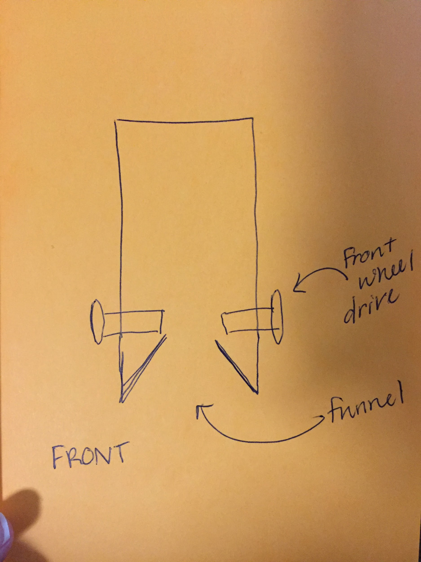
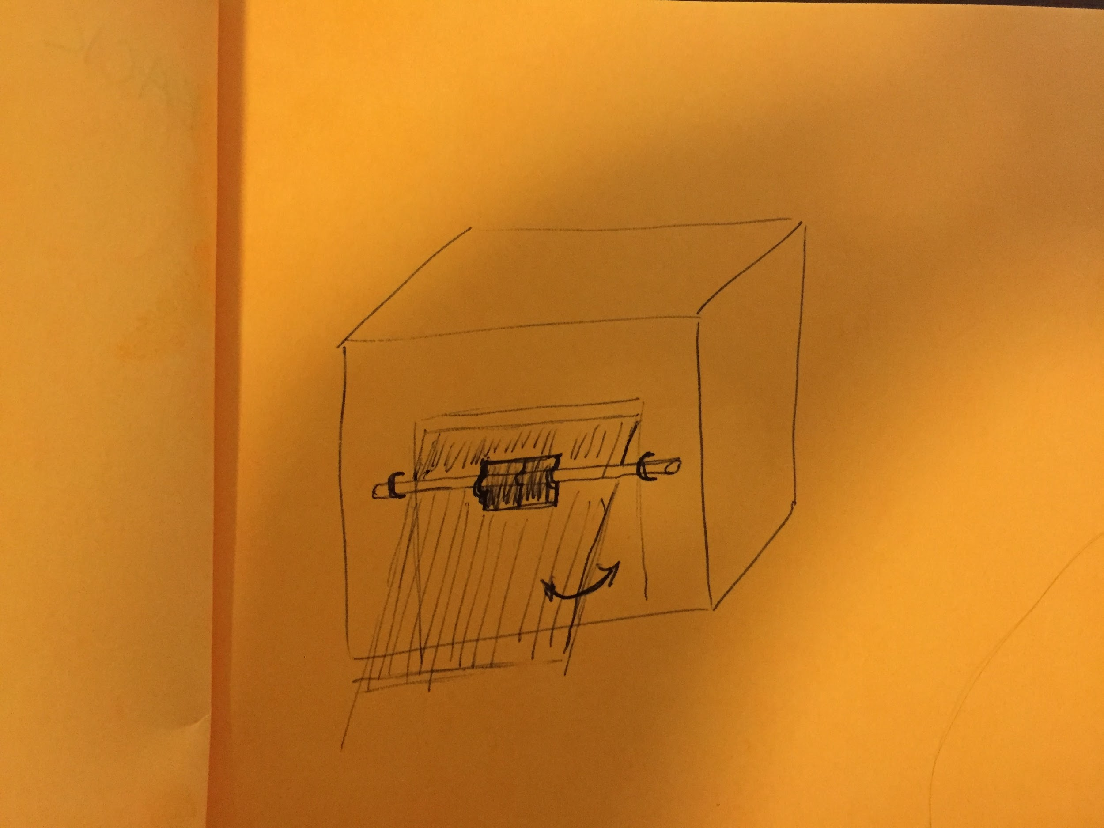
Concepts
Front Wheel Drive Ball “Funnel”
Axle Flap Door

Slide 16
Container Prototype
Pros:
Easy to build
Cons:
Requires a lot of force on the ball to push through doors

Slide 17
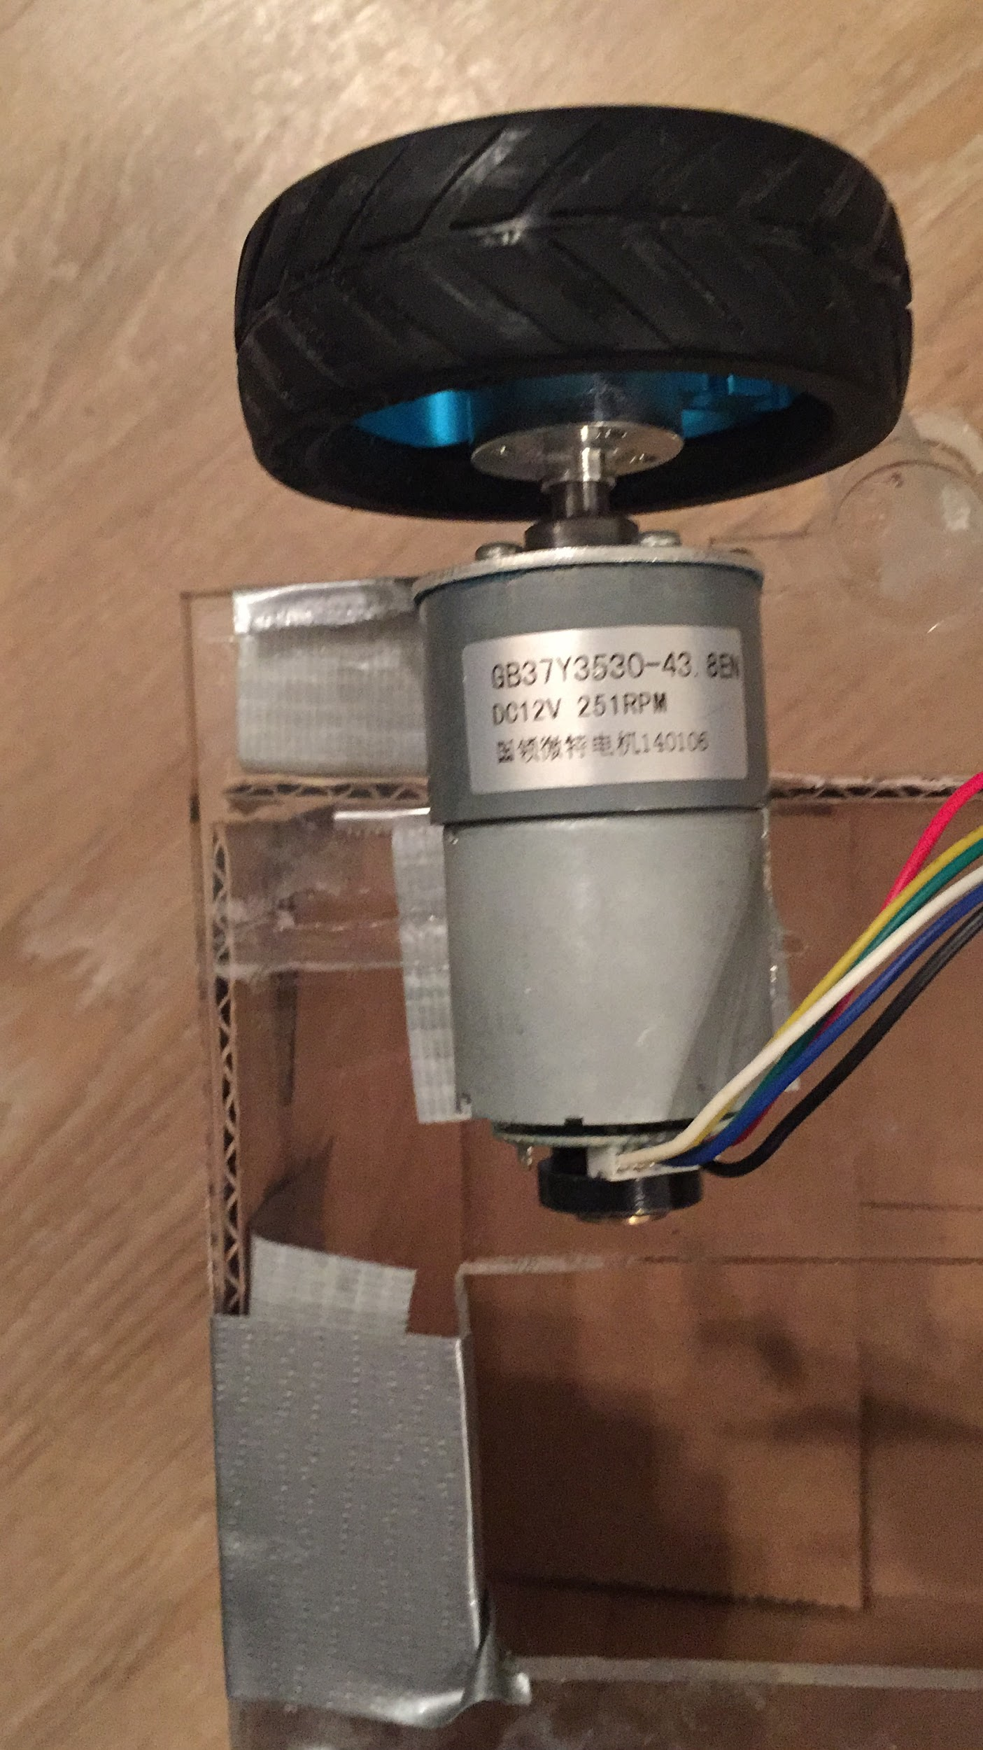
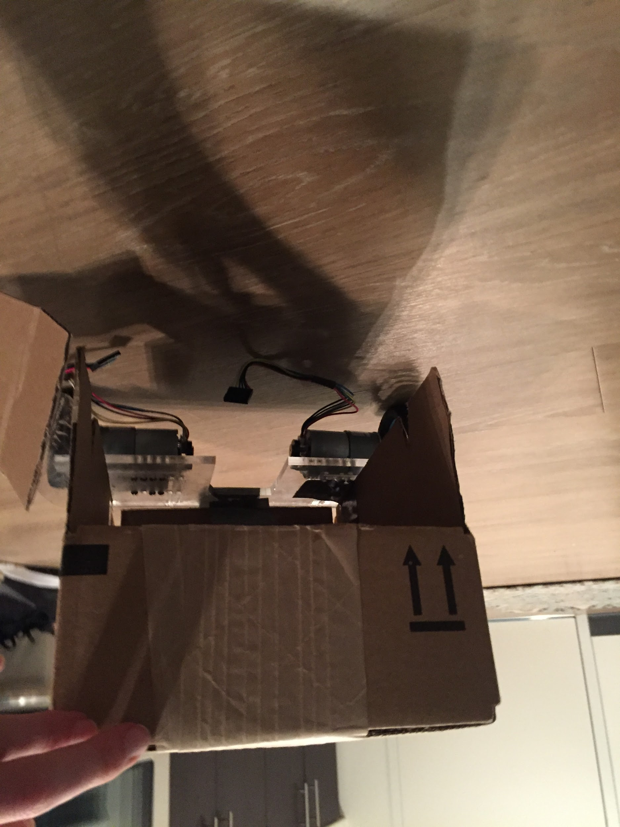
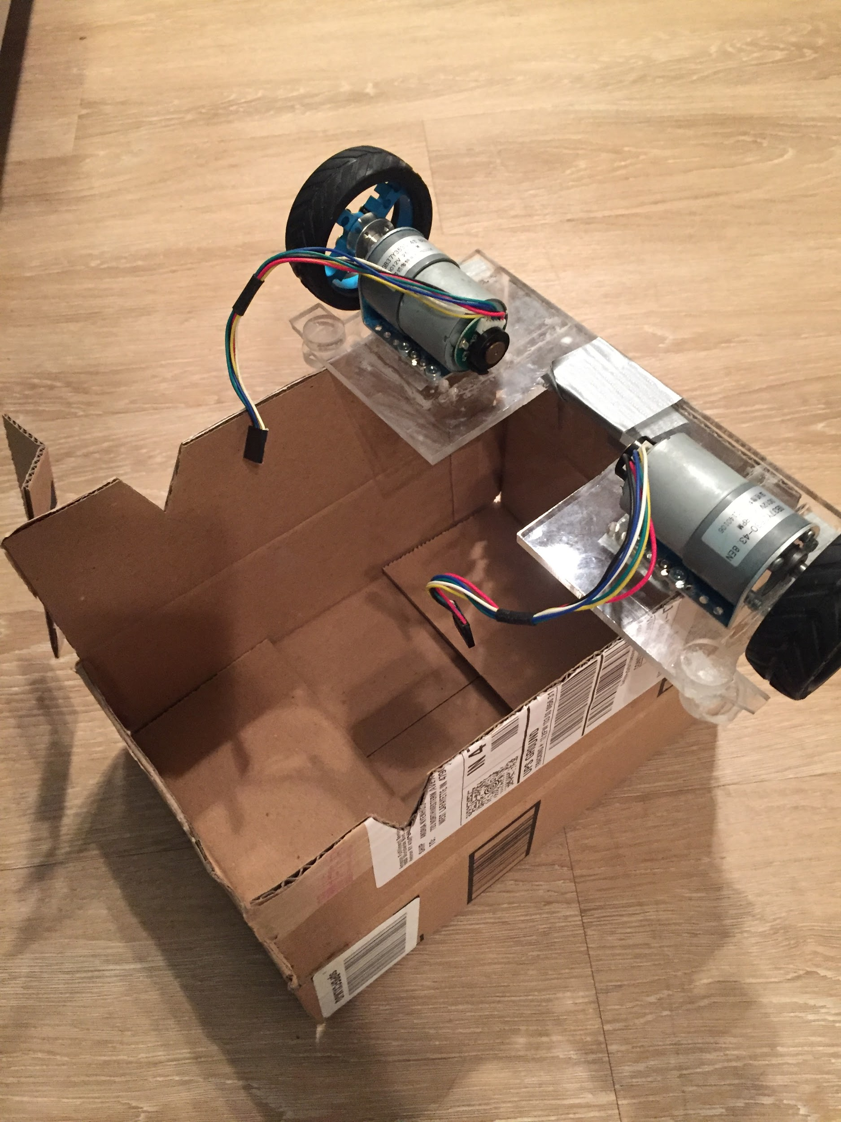
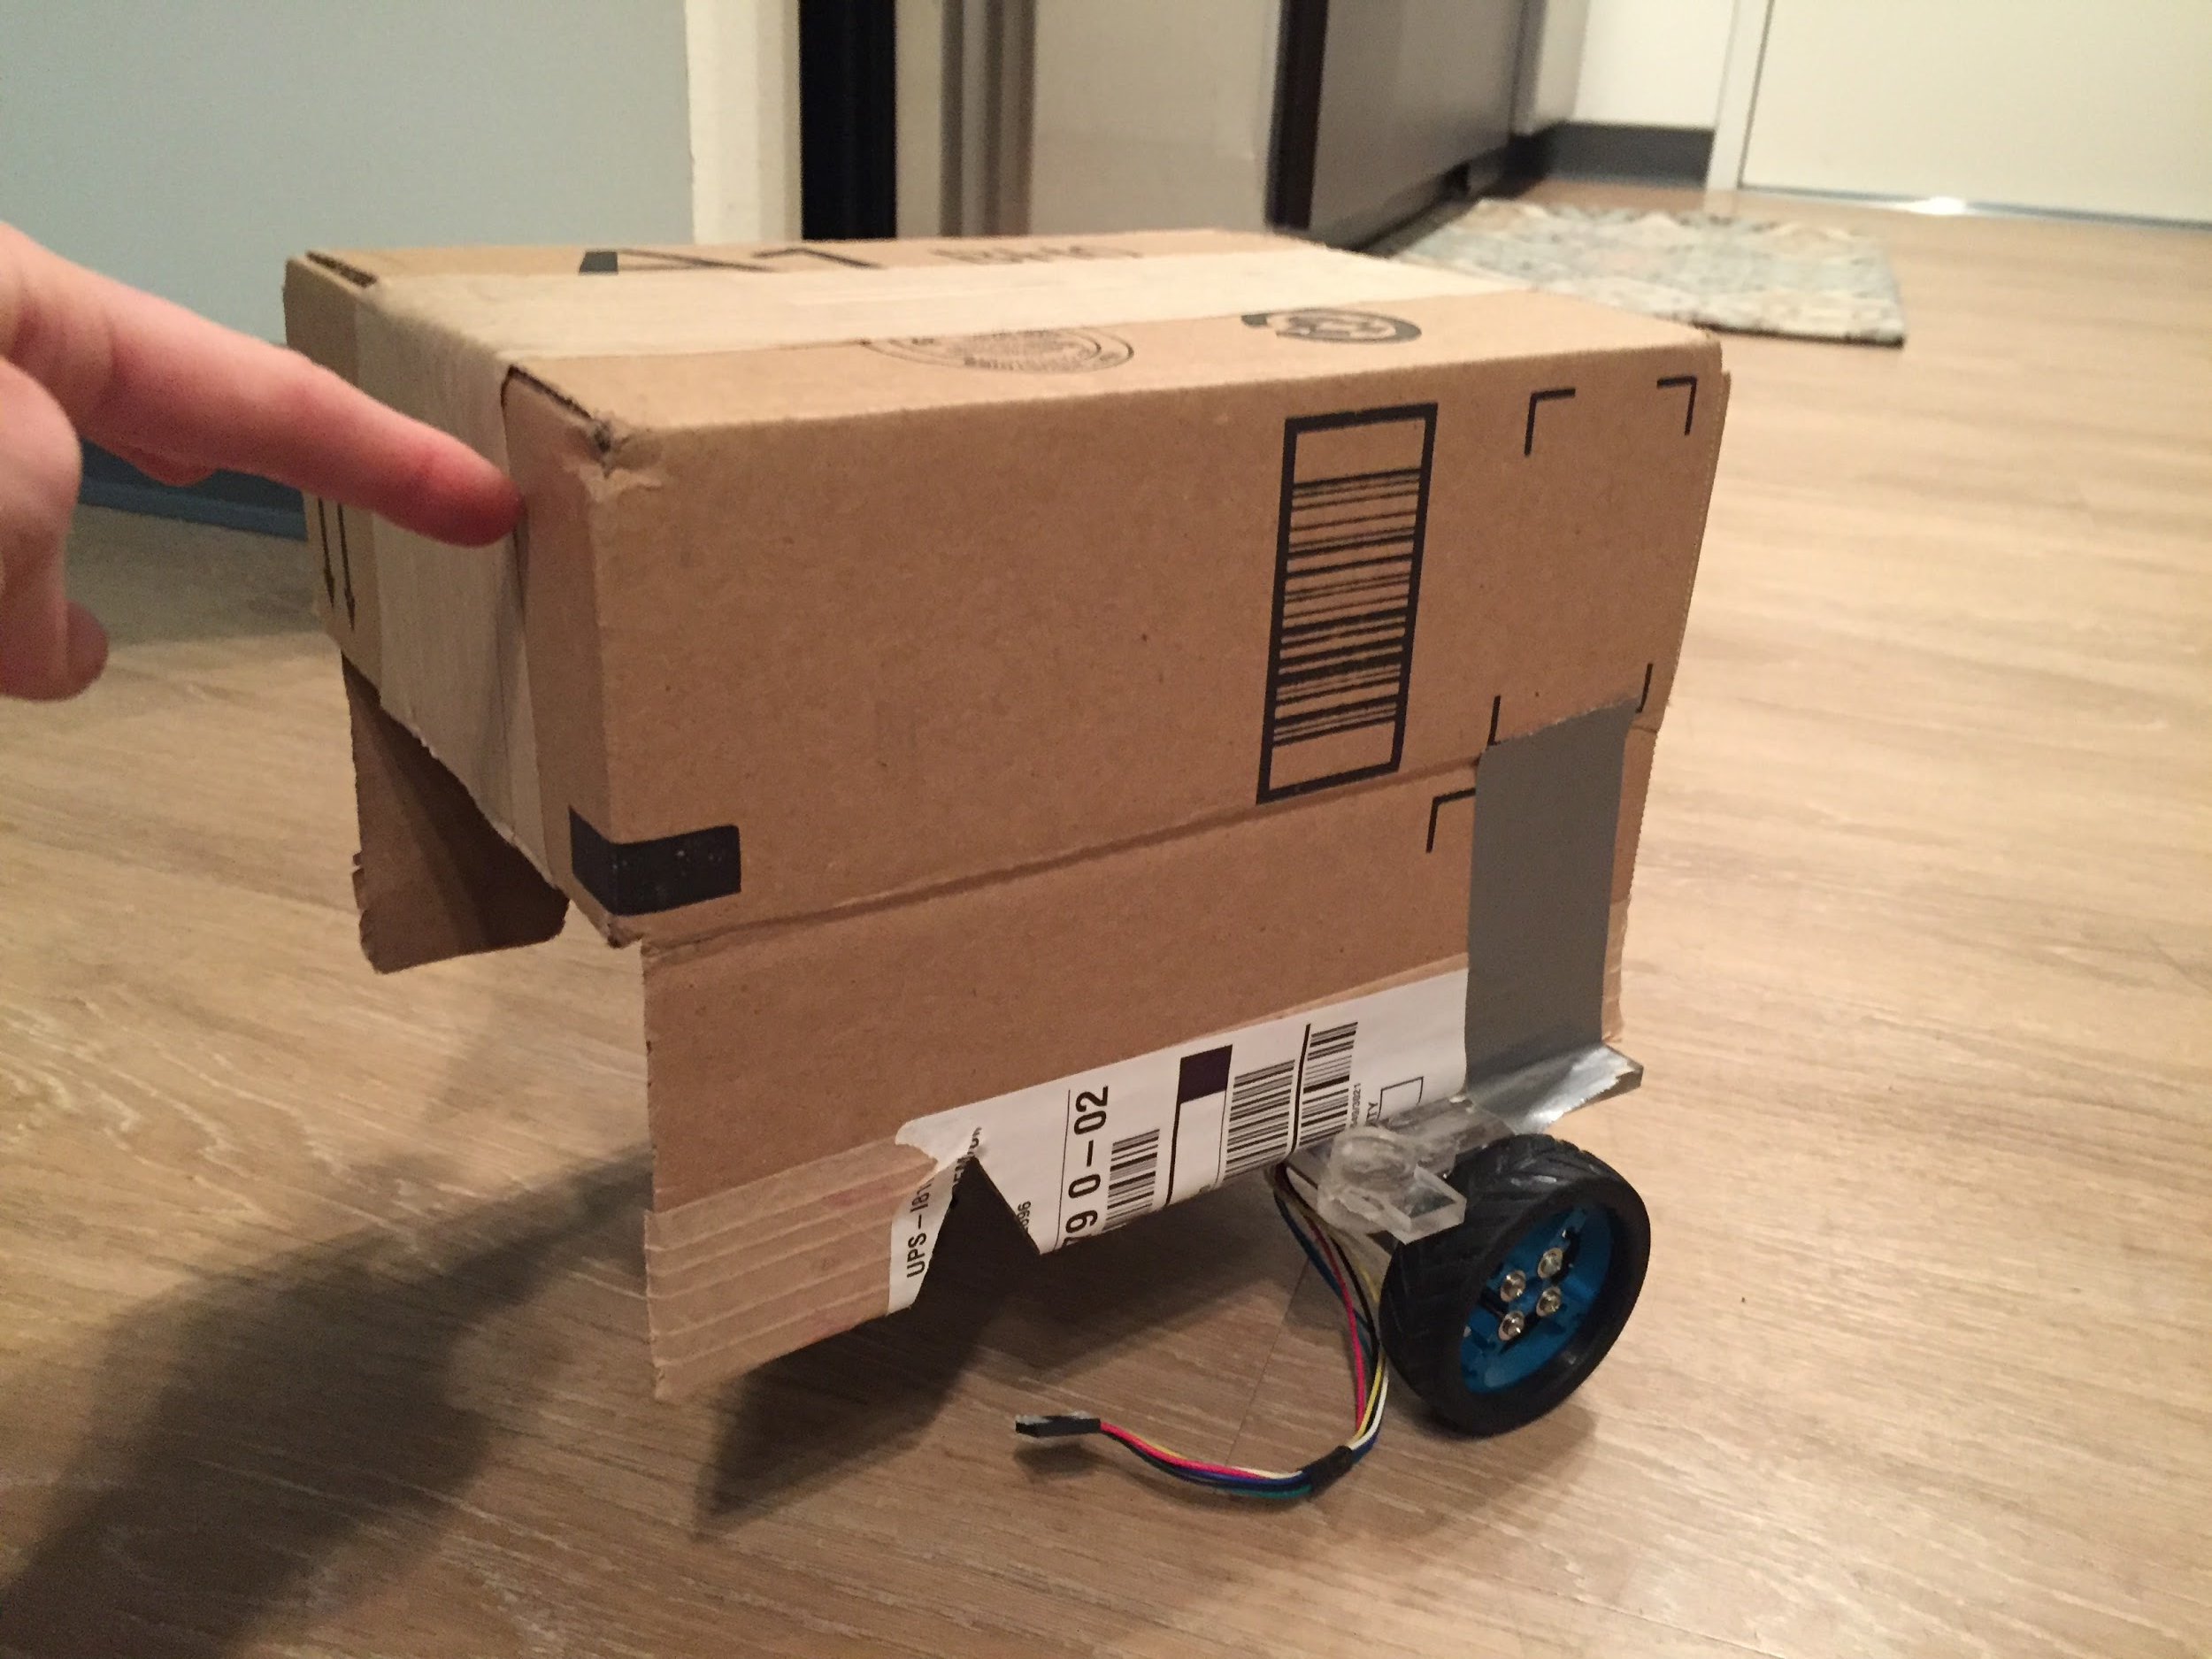
Vehicle Prototype
10”x7”x7”
GB37Y3530-43 8EN
2.5” wheel

Slide 18
Questions to ask in class
Where to source our PCB through
Door dimensions
Door close time

Slide 19
https://cdn-learn.adafruit.com/downloads/pdf/pixy-pet-robot-color-vision-follower-using-pixycam.pdf
https://create.arduino.cc/projecthub/junejarohan/ball-tracking-robot-7a9865
http://www.instructables.com/id/Pixybot-robots/?ALLSTEPS

Slide 20
GitHub repository
https://github.com/MrBanana211/Mars_Mission

